Slide 1
Learning from nearest neighbours

Slide 2
Training dataset means data which is already available and used to discover potentially predictive relationships, whereas query point is point under examination.
Learning means finding the category/label associated with a query point using training data set.
The simplest method to classify the query point is to assign label based on training points which are closest to query point.

Slide 3
Framework of nearest neighbours
Consider following points while designing nearest neighbours:
The ‘distance’ measure to be used. E.g. Euclidian distance, angle between two vectors
‘Number’ of nearest neighbours to be looked upon
Weight of nearest neighbours so that the nearer neighbours contribute more to the average than the more distant ones.
Defining label to be associated with the query.

Slide 4
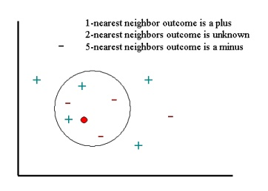
Simplest case : Learning from one nearest neighbour
Choose only the one neighbour that is nearest the query example.
No use of weighing the neighbour as there is only one contributor
Label of the query point would be same as that of nearest neighbour.

Slide 5
Learning One-Dimensional Functions
Consider training examples of the form (x,y). So training dataset is a collection of samples of the value of a function y = f(x) for certain values of x
Consider the following
k- number of nearest neighbours (x1, x2, . . . , xk )
Wi - the weight associated with each point (xi,yi)
The estimate of the label y for x is
∑i=1 wiyi / ∑ i=1 wi

Slide 6

Example
Let the training set be (1, 1), (2, 2), (3, 4), (4, 8), (5, 4), (6, 2), and (7, 1).
Let the query point be x=3.8
Possible ways to find out label for query point
Nearest Neighbor : Using one nearest neighbour. Here, it would be (4,8) and label for x is 8.
Average of the Two Nearest Neighbors : Choose 2 nearest neighbours and take averge of them ( assigning equal weight (half) to both the points.
Weighted Average of the Two Nearest Neighbors : Choose 2 nearsest neighbours and assign them weight ( let the weight be inverse of distance of neighbour from query point ) The weighted average would be
Average of Three Nearest Neighbors : Let k =3 and either average out the weight ( w=1/3) or assign the weight to calculate the label.
The question would be : which method would be fastest and give accurate results?

Slide 7


Kernel Regression
Construct a continuous function that represents the data of a training set to consider all points in the training set assigning relative weight to each point.
E.g. Consider ‘bell-curve’ ( normal distribution ) so that weight of training point x when the query is q is
σ = standard deviation of the distribution
By this means, points within distance σ of q are heavily weighted, and those further away have little weight. As q approaches x, the label of x dominates all the other points.

Slide 8
Dealing with High-Dimensional Data
For a high dimensional data ( e.g. articles of 1000 words each would make 1000-D data ), a large portion of data needs to be searched to find nearest neighbour.
Two ways to deal with ‘high dimensionality’ :
1. VA Files : Scan the files in two-stage manner.
First, create summary of each data ( e.g. using only higher 2 bytes from 8 bytes data and hence reducing it by ¼). Scan this data, and construct a list of candidates that might be among the k nearest neighbours of the query q.
Look up these small fraction of entire file to find k-nearest neighbours.
2. Dimensionality Reduction :
Reduce the dimensions of training data set as well as query vector q and then search for q’s nearest neighbours. Eg. Use Locality Sensitive Hashing ( LSH ) to reduce dimensions.

Slide 9

Dealing with Non-Euclidean Distance
For high dimensional data, if we consider distance function d such that d(x,q) is distance of query point q from point x then, weight of x in normal distribution is determined as :

Slide 10
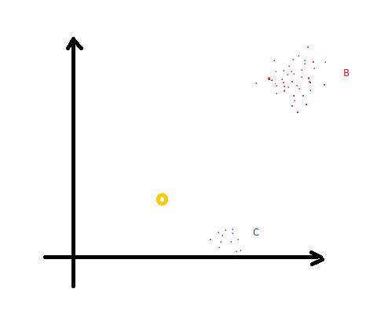
Questions
How to find nearest neighbours if training data is completely non-uniform.
Suppose query data set is very small compared to training data set. Then its nearest neighbour might be wrong as it could match with dataset with less no of matched elements. How to handle this situation ?
Query point O is similar to training
Dataset B but due to smaller size it is
Near to point C which is incorrect.

